Slide 1
Software Engineering :
10 : Software Architecture Part 3
Professor Imed Bouchrika National School of Artificial Intelligence imed.bouchrika@ensia.edu.dz

Slide 2
Outline :
Part 1:
Introduction to Software Architecture
Software Architecture Process
Selecting Technological Stack
Architecture Quality Attributes
Software Architectural Styles
Part 2 :
Programming Questions
Design Patterns
Architecture Principles : SOLID
Part 3 :
Structured Design : History
Decoupling & Cohesion
Architectural Techniques
Documenting the Architecture
Case Study

Slide 3
Structured Design
Software Crisis :
a term used in the early days of computing science for the difficulty of writing useful and efficient computer programs in the required time due to
Existing methods were inadequate.
Complexity of software systems.
The systems became very complicated to maintain.
The term "software crisis" was coined by some attendees at the first NATO Software Engineering Conference in 1968 in Germany

Slide 4
Structured Design
From Structured Programming and Modular Programming
Structured programming (Use of Subroutines + Control flow blocks) began in 1950s.
Modular programming started in 1960s where each functionality or part of the system is implemented as a separate “independent?” module with an interface.
The aim of modularization is to slow down of what’s called software entropy, before the system becomes unmanageable due to its complexity.
Software entropy = the risk that changing existing software will result in unexpected problems, unmet objectives, or total failure.

Slide 5

Structured Design
From Structured Programming and Modular Programming
“David Lorge Parnas (born February 10, 1941) is a Canadian early pioneer of software engineering, who developed the concept of information hiding in modular programming, which is an important element of object-oriented programming today. He is also noted for his advocacy of precise documentation.”

Slide 6
Structured Design
From Structured Programming and Modular Programming
What’s a module : depending on at which level of abstraction you look from :
Sub-system
Plugin
Component
Package
Service
Class
Or even a function

Slide 7
Structured Design
From Structured Programming and Modular Programming
What’s a module : depending on at which level of abstraction you look from :
Sub-system
Plugin
Component
Package
Service
Class
Or even a function
Any entity at any level as long as it has a boundary which isolates or hides its inside from the outside via interface(s)
Interface here is not the interface as in Java/C++..

Slide 8
Structured Design
Interface : Linking Modules
Linking modules is done via via an interface : “Any such referenced element defines an interface, a portion of the module boundary across which data or control flow. […] you may think of it as a socket into which the plug, represented by the connection from the referencing module, is inserted. Every interface in a module represents one more thing which is/must be known, understood, and properly connected by other modules in the system.” Taken from the Structured Design Book.

Slide 9
Structured Design
Interface : Linking Modules
Linking modules is done via via an interface : “Any such referenced element defines an interface, a portion of the module boundary across which data or control flow. […] you may think of it as a socket into which the plug, represented by the connection from the referencing module, is inserted. Every interface in a module represents one more thing which is/must be known, understood, and properly connected by other modules in the system.” Taken from the Structured Design Book.
A public method of a class can be considered one of its interface. Or a public static/instance variable Or a network socket Or API Endpoint …

Slide 10
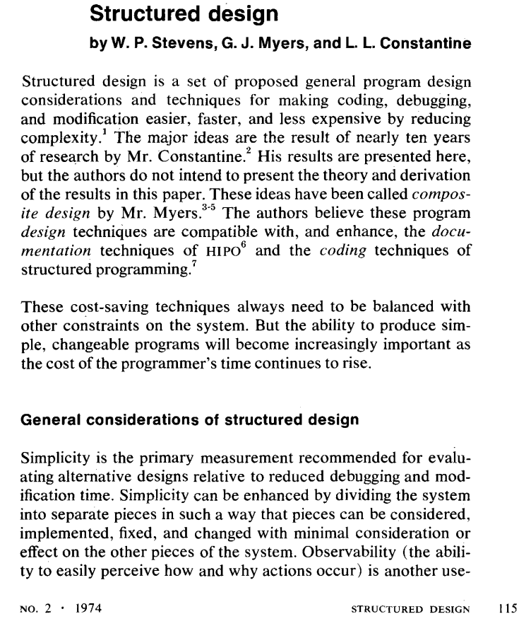
Structured Design
From Structured Design to Software Architecture
Structured Design : high level of how divide a system into components /modules and connect them together (1974)
This is what’s known today as software architecture

Slide 11
Structured Design
Will modularization be the panacea to producing optimal software ?

Slide 12
Structured Design
Module 1
Module 2
Module 3
Module 4
Module 5
Module 6

Slide 13
Structured Design
Module 1
Module 2
Module 3
Module 4
Module 5
Module 6

Slide 14
Structured Design
Replacing Module 1 by another new module may still impact all other modules
Module 1V2
Module 1
Module 2
Module 3
Module 4
Module 5
Module 6

Slide 15
Structured Design
Modules are HIGHLY CONNECTED via many interfaces ?
Module 1
Module 2
Module 3
Module 4
Module 5
Module 6

Slide 16
Structured Design
50 Years : Developing Software now ?
When it comes to Web Applications, many applications are perceived as just doing the HTML design/coding and link it with some JavaScript files or PHP to do backend business logic.
But :
When it comes to maintainability or scalability, the software will fail.
Example : Implementing the undo features for the to-do App.

Slide 17
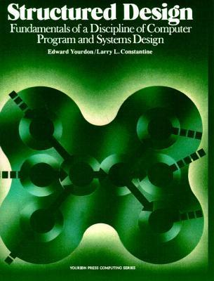
Structured Design : Cohesion and Coupling
Most important terms :
As modularization is not enough to solve and reduce the complexity of software, but rather how modules are made and connected to each other.
The book “Structured Design, 1975” introduced the two notions:
Cohesion
Coupling
They become the most important concepts and metrics for perceiving the quality of good software

Slide 18
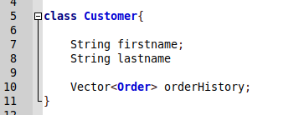
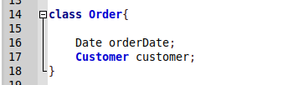
Coupling and Cohesion
Customer and Order Classes:
Two modules : Customer + Order

Slide 19
Coupling and Cohesion
Customer and Order Classes:
Two modules : Customer + Order
Can the Customer Module re-used in other systems ? ( Without the Order Class ?
No : Because the Customer is coupled/tied to the Order class

Slide 20
Coupling and Cohesion
Coupling
Definition :
Coupling is the measure of the degree of interdependence between the modules.
A good software will have low coupling.
Degree of interdependence can be measured by :
Number of interfaces
Types or complexity of dependency

Slide 21
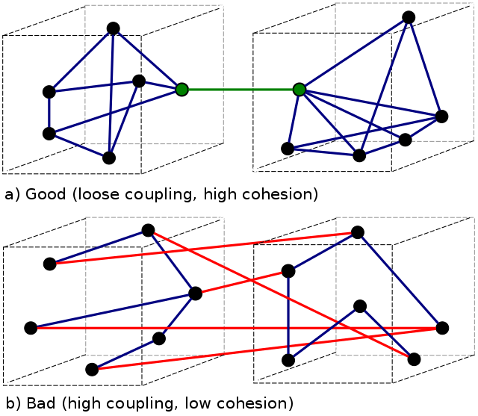
Coupling and Cohesion
Coupling
Good Software : Low/Loose Coupling
Bad Software : High Coupling

Slide 22
Coupling and Cohesion
Why low Coupling is good
Improved Maintainability: Low coupling reduces the impact when changing one module risking to change other modules. Therefore, making it easier to modify or replace individual components without impacting the entire system.
Enhanced Modularity: Low coupling allows modules to be developed and tested in isolation. Therefore, improving the reusability of code and modules in other systems
Better Scalability and Extensibility: Low coupling facilitates the addition of new modules and the removal of existing ones.

Slide 23
Coupling and Cohesion
Types Coupling
Data Coupling:
When data of one module is passed to another module, this is called data coupling.
Example :
A module gets the customer addressed (data) from another module by an API endpoint.

Slide 24
Coupling and Cohesion
Types Coupling
Stamp Coupling:
Two modules are stamp coupled if they communicate using composite data items such as structure, objects, etc.
Called also : data-structured coupling
Example :
Need to get the name from another module.
Passing structure variable or object where the name is retrieved from the structure.

Slide 25
Coupling and Cohesion
Types Coupling
Control Coupling:
Control Coupling exists among two modules if data from one module is used to direct the structure of instruction execution in another.
Example :
We need to compute the salary for an employee in a given module, the control logic is dependent or tied to the data being retrieved from the absence module.

Slide 26
Coupling and Cohesion
Types Coupling
External Coupling:
Can be described as a situation where the modules are interrelated with common external influencing factors such as:
an external legacy application that sends the same set of data or contents to both modules
A hardware requirement common for both modules
A common file/ folder in use by both modules
When both use same switch/router in the network for communication

Slide 27
Coupling and Cohesion
Types Coupling
Common Coupling:
Common coupling is said to occur when two or several modules have access to the same global data
Example
A module writes data to a file which is used by another module.

Slide 28
Coupling and Cohesion
Types Coupling
Content Coupling:
Exists among two modules if they share code, e.g., a branch from one module into another module. ( Invocation of a function )
Example :
A class invokes another class.

Slide 29
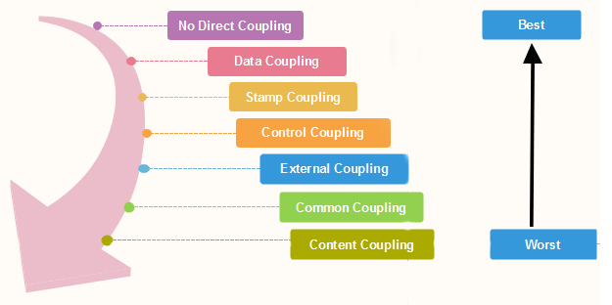
Coupling and Cohesion
Types Coupling

Slide 30

Coupling and Cohesion
Cohesion
Definition :
The degree to which the elements of a module belong together.
It measures the strength of relationships between pieces within a module based on a given aspect :
Functionalities
Objectives
…

Slide 31
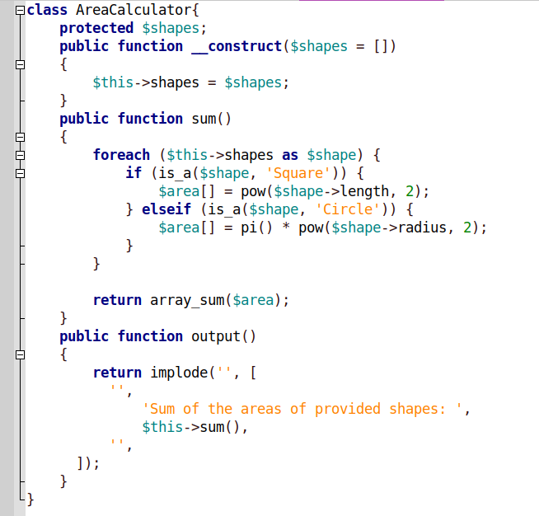
Coupling and Cohesion
Cohesion
Remember the class for shapes, it has two methods
ComputeArea
OutputArea
Those two functionalities are
Not related
Not cohesive

Slide 32
Coupling and Cohesion
Why High Cohesion is a good quality
Improved readability and understandability: High cohesion results in clear, focused modules with a single, well-defined purpose, making it easier for developers to understand the code and make changes.
Better error isolation: High cohesion reduces the likelihood that a change in one part of a module will affect other parts, making it easier to
isolate and fix errors. Improved reliability: High cohesion leads to modules that are less prone to errors and that function more consistently,

Slide 33
Coupling and Cohesion
Types or Levels of Cohesion
Functional Cohesion : different elements of a module, cooperate to achieve a single function
Sequential Cohesion : element of a module form the components of the sequence, where the output from one component of the sequence is input to the next.
Communicational Cohesion : when all tasks of the module refer to or update the same data structure, e.g., the set of functions defined on an array or a stack.

Slide 34
Coupling and Cohesion
Types or Levels of Cohesion
Procedural Cohesion : A module is said to be procedural cohesion if the set of purpose of the module are all parts of a procedure in which particular sequence of steps has to be carried out for achieving a goal, e.g., the algorithm for decoding a message.
Temporal Cohesion : When a module includes functions that are associated by the fact that all the methods must be executed in the same time
Logical Cohesion :When all the elements of the module perform a similar operation. For example Error handling, data input and data output, etc.
Coincidental Cohesion : A module is said to have coincidental cohesion if it performs a set of tasks that are associated with each other very loosely, if at all.

Slide 35
Coupling and Cohesion
Coupling vs. Cohesion vs. Good Design
Advocates of structured design emphasis clearly that neither coupling nor cohesion are absolute truth: in design, everything is a trade-off. The trade-off is always based on experience, the benefits of the solutions, the drawbacks possibly to be faced.
That’s why :
Exploring and experimenting is so important.
Software development is always difficult.

Slide 36
Architectural Techniques
What can be done to meet the technical attributes
Use of architectural design
Combine if necessary
Ensure the use design patterns
Use other architectural techniques
Caching ( Remote, vs. Cloud. Vs. Client…..)
Messages
…

Slide 37
Documenting Software Design and Architecture
The Software Architecture Document contains information about :
Components and their mapping and structuring
Technological Stack
Functional and nonfunctional requirements
Architectural diagrams including UML diagrams.
Executive Summary
The document should describe what should be developed and how including the list of modules and how they should be communicating
Important : No development before the document.

Slide 38
Documenting Software Design and Architecture
Structure of the document :
Background : short section to describe briefly the system from a business point of view discussing :
System objectives
What the system do from the end-user perspective
Expected business impact
This section should never contain technical details.

Slide 39
Documenting Software Design and Architecture
Structure of the document :
Requirements :
This includes a brief (not detailed) listing of :
Functional requirements
Non-functional requirements including the technical capacities which are not mentioned explicitly in the SRS document.

Slide 40
Documenting Software Design and Architecture
Structure of the document :
Executive Summary:
The audience of this section is the management team.
Management are non-technical and are usually business-oriented people.
The goal of this section is to provide a high-level view of the architecture to convince the audience that the proposed solution is viable.
Executive summary : should not contain background information or the requirements again.

Slide 41
Documenting Software Design and Architecture
Structure of the document :
Executive Summary:
The audience of this section is the management team.
Management are non-technical and are usually business-oriented people.
The goal of this section is to provide a high-level view of the architecture explaining the decision and choices taken to convince the audience that the proposed solution is viable.

Slide 42
Documenting Software Design and Architecture
Structure of the document :
Architecture Overview:
It would provide a high-level of the architecture
Shall be started with a general introduction describing the type of the application, the choice of architectural styles of the reasons for it.
It would include High-Level Diagram showing all architectural components composing the system.
A brief description of each component shall be provided
Technological Stack : Better to describe in the next section

Slide 43
Documenting Software Design and Architecture
Structure of the document :
Components/Services/Subsystems/Classes
Each components shall be extremely detailed. This includes:
Component roles
Components Elements
UML Diagrams if necessary.
Component APIs/Interfaces with arguments and response structure codes ( include even function names..)
Data Format
Technological Stack or constraints
Development guidelines

Slide 44
Software Engineering : First Week
This course is not programming, but the use of best practices in software engineering to develop a software product meeting the quality attributes.
The aim is not code/implement the functional requirements completed, but to have :
Maintainable Software
Extensible
Scalable…
Remember, there is no “simple software” or “simple/easy code”.

Slide 45
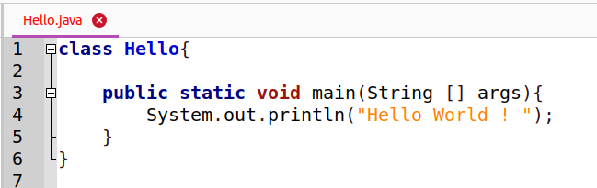
Case Study 1 : Show Hello World
Example from the first Lecture :

Slide 46
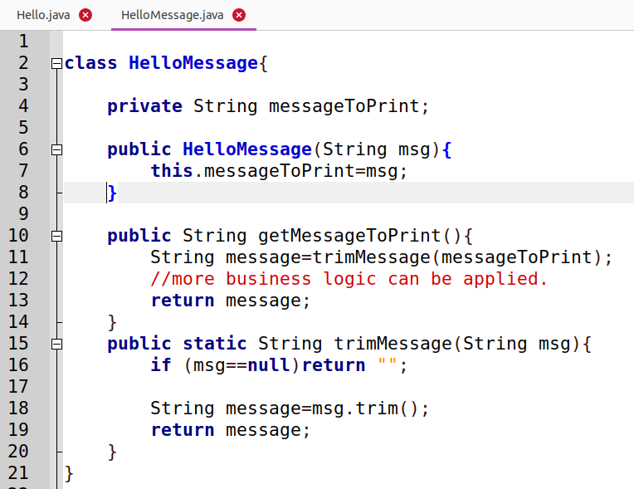
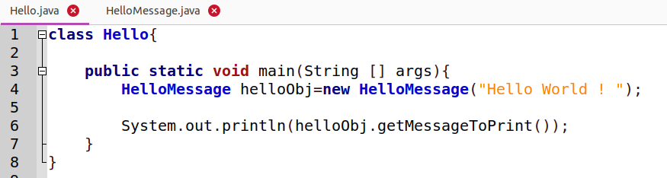
Case Study 1 : Show Hello World
Architecture :
Modularization and encapsulation inside a class
Facade Pattern is used where a single facade method is provided calling all other private functions

Slide 47
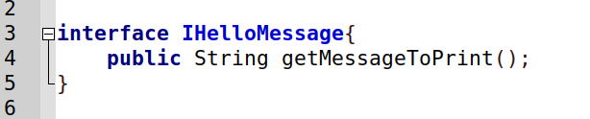
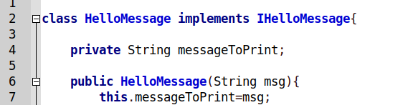
Case Study 1 : Show Hello World
Architecture :
We work always with Abstraction, provide an interface with public method

Slide 48
Case Study 1 : Show Hello World
Architecture :
There is some glue here…what if we want to change the concretion,,,,

Slide 49
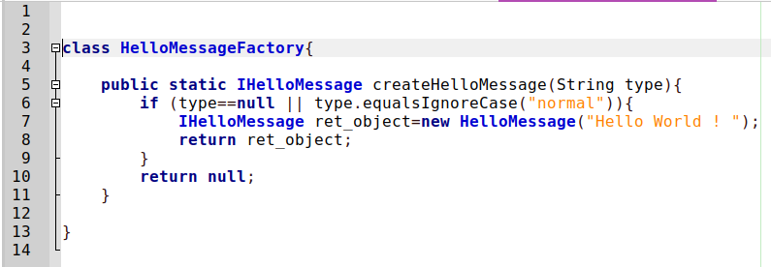
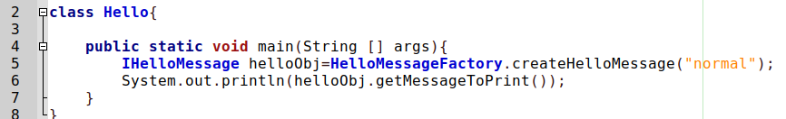
Case Study 1 : Show Hello World
Factory Pattern method is created
Inside the main method, we don’t need to know how it is created nor its actual real class.

Slide 50
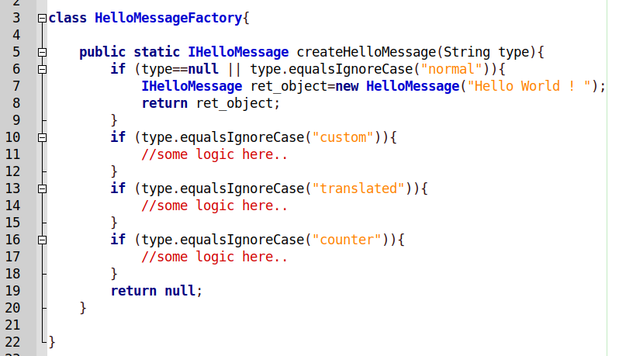
Case Study 1 : Show Hello World
Extensibility ? easy now

Slide 51
Case Study 1 : Show Hello World
Architecture :
Different Levels of Abstraction : Creating some complex object vs. printing to the console ? Let’s apply more modularisation: Creation + Display : which pattern ?

Slide 52
Case Study 1 : Show Hello World
Architecture :
Different Levels of Abstraction : Creating some complex object vs. printing to the console ? Let’s apply more modularisation: Creation + Display : which pattern ?

Slide 53
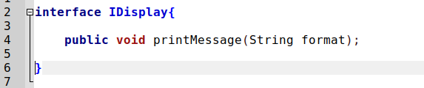
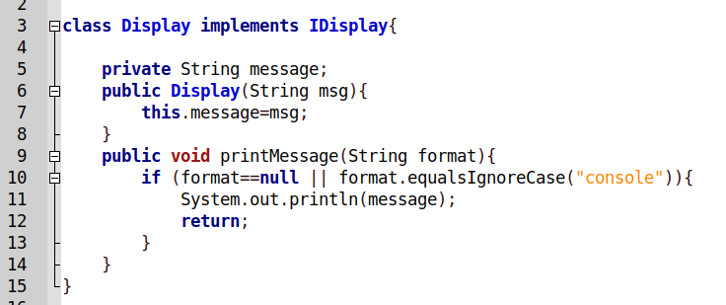
Case Study 1 : Show Hello World
Architecture :
Extensibility ? Other formats ? Gui ? PDF

Slide 54

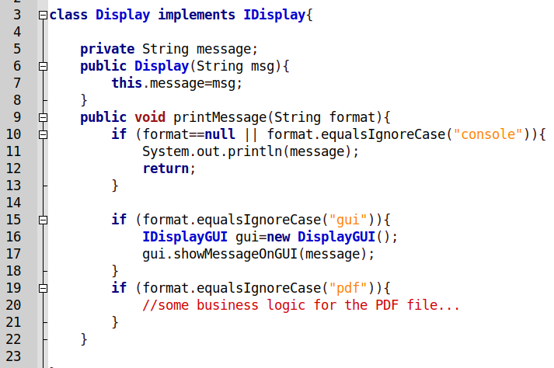
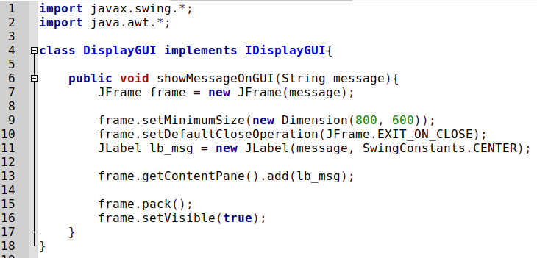
Case Study 1 : Show Hello World
Architecture :
Adapter Pattern

Slide 55
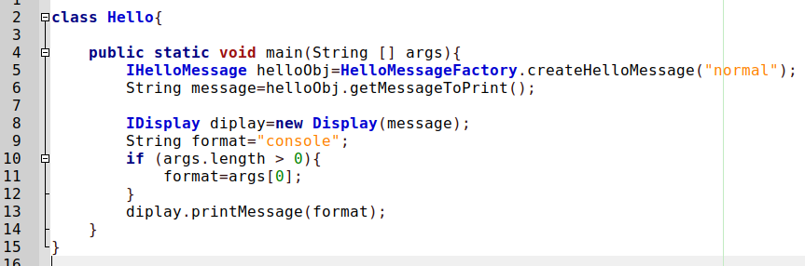
Case Study 1 : Show Hello World
Architecture :
Adapter Pattern

Slide 56
Case Study 1 : Show Hello World
Architecture :
This is a mess ?

Slide 57
Case Study 1 : Show Hello World
We create another module to parse command line arguments Who knows, in case of a change in the future, it won’t impact all modules Ex, program -o gui -d 900x600 ?
Architecture :

Slide 58
Case Study 1 : Show Hello World
Using the principles of Software Engineering :
Any feature to be added, it is easy.
The modules are fully reusable. I can use the Display Module with other software.
The code is very readable and can be maintained with ease.
New Feature ?

Slide 59
Case Study 1 : Show Hello World
Using the principles of Software Engineering :
New Feature :
We would like to perform some post-processing on the text
May be
Convert all letters to capitals
Remove digits
I will tell you other actions next month

Slide 60
Case Study 1 : Show Hello World
Using the principles of Software Engineering :
New Feature :
We would like to perform some post-processing on the text
May be
Convert all letters to capitals
Remove punctuation marks
I will tell you other actions next month
Doable ?

Slide 61
Case Study 1 : Show Hello World
Using the principles of Software Engineering :
New Feature :
We would like to perform some post-processing on the text
May be
Convert all letters to capitals
Remove punctuation marks
I will tell you other actions next month
Doable ? Which design Pattern ?

Slide 62

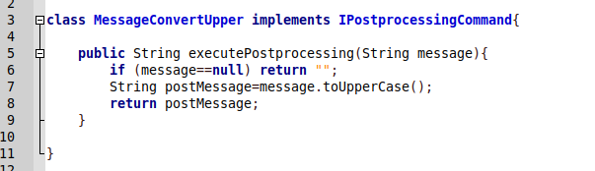
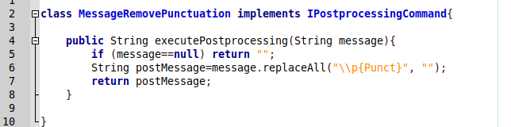
Case Study 1 : Show Hello World
Invoking a number of action in a unified way :
Command Pattern

Slide 63
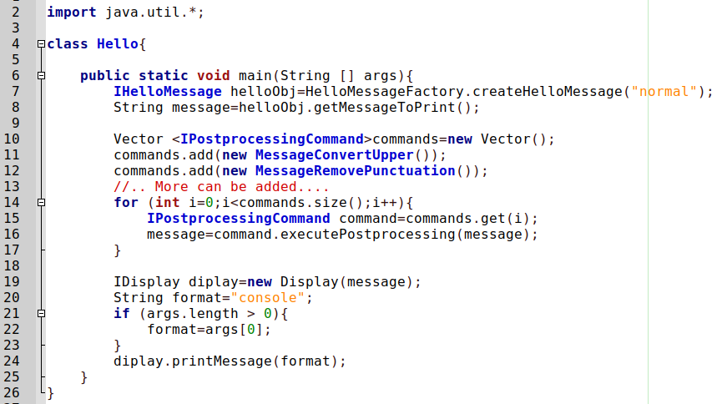
Case Study 1 : Show Hello World
Invoking a number of action in a unified way :

